Slide 1

Library Management
System
A full-stack web application meticulously crafted using Node.js, Express, MySQL, and EJS. This system streamlines library operations. Manual processes are automated for efficiency and accuracy. Explore the future of library management.
Parepally Aravind (2401MC36)
Hima Sai Chandana (2401MC37)

Slide 2
Addressing the Problem
The Challenge
Our Objective
Manual library operations are inefficient and error-prone.
Automate book issuing and returns.
These traditional methods consume valuable time and resources.
Enable efficient book search.
Maintain accurate records.

Slide 3





Technology Stack
Frontend
HTML, CSS, JavaScript, EJS templates
Backend
Node.js, Express.js
Database
MySQL
Libraries &Tools
express-session,body-parser,mysql,font-awesome

Slide 4




System Architecture
Client
Server
Database
Web Browser (EJS-rendered pages)
Node.js with Express (logic, routing)
MySQL (stores user, book records)
Our three-tier architecture ensures scalability and maintainability. Session management is handled securely on the server.

Slide 5

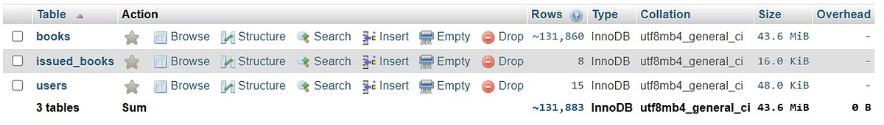
Database Design
Users
Books
Issued Books
user_id
book_id
issue_id
username
title
user_id
email
author
book_id
password
publisher
issue_date

Slide 6

Key Features
1
User Authentication
2
Search Functionality
3
Book Issuing
Secure signup/login with session management.
Filter books by title, author, or publisher.
Records issue date, auto-calculates due date.
4
Book Returning
5
User Dashboard
6
User Profile
Removes issued book from database
Displays user's cuurently issued books
Display's username, user ID and Email

Slide 7
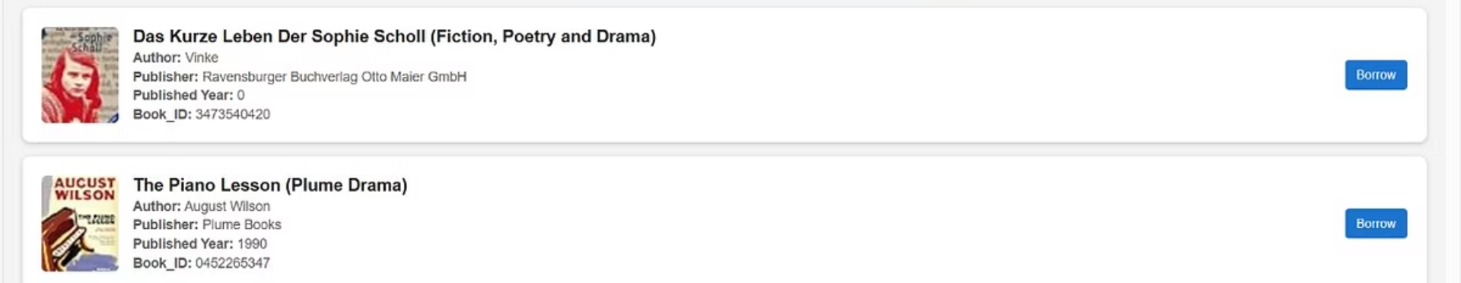
User Interface and Experience
User-Friendly Search
Responsive Layout
Efficient filtering options.
Intuitive Navigation
Optimized for desktop and mobile.
Clean design for ease of use.

Slide 8




Backend Functionality
/signup
/login
/dashboard
/browse
/issue & /return

Slide 9








Overcoming Challenges
Large Datasets
Session Management
Implemented pagination for search results.
Used express-session for persistence.
UI Responsiveness
Data Accuracy
Clean layout using modular EJS and CSS
Backend input validation.

Slide 10

Conclusion
A fully functional, scalable LMS built with key features including user authentication, book search, and issuing/returning logic.
Future Enhancements:
• Admin Dashboard
• Overdue book reminders
• Book Ratings & Reviews
Thank you!

